Slide 1
Oil Pastel Animal Eyes

Slide 2
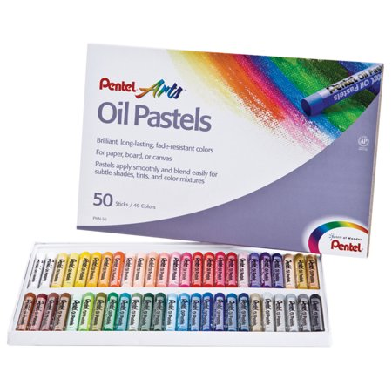
Oil Pastel Maintenance
Use a paper towel to wipe off your oil pastel.
Be sure to clean pastels to avoid unwanted color transfer.

Slide 3
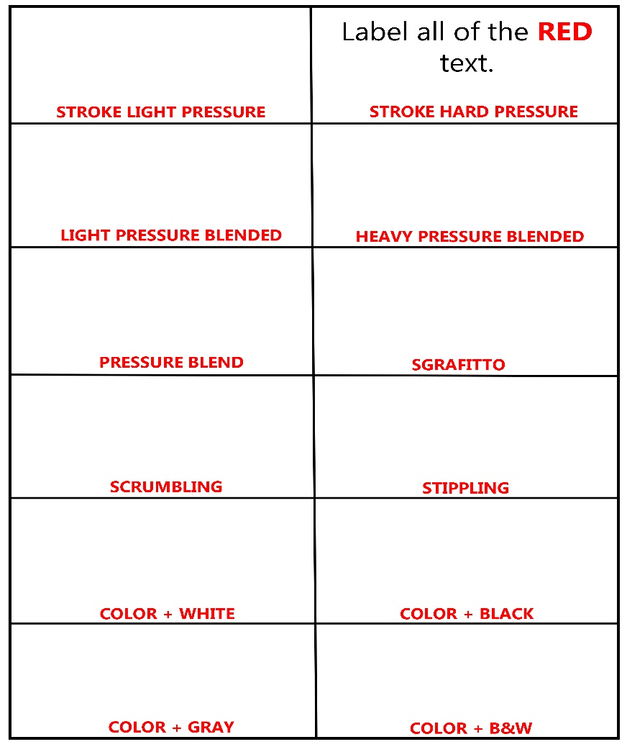
Oil Pastel Technique
Click HERE for a step-by-step tutorial on oil pastel technique.

Slide 4
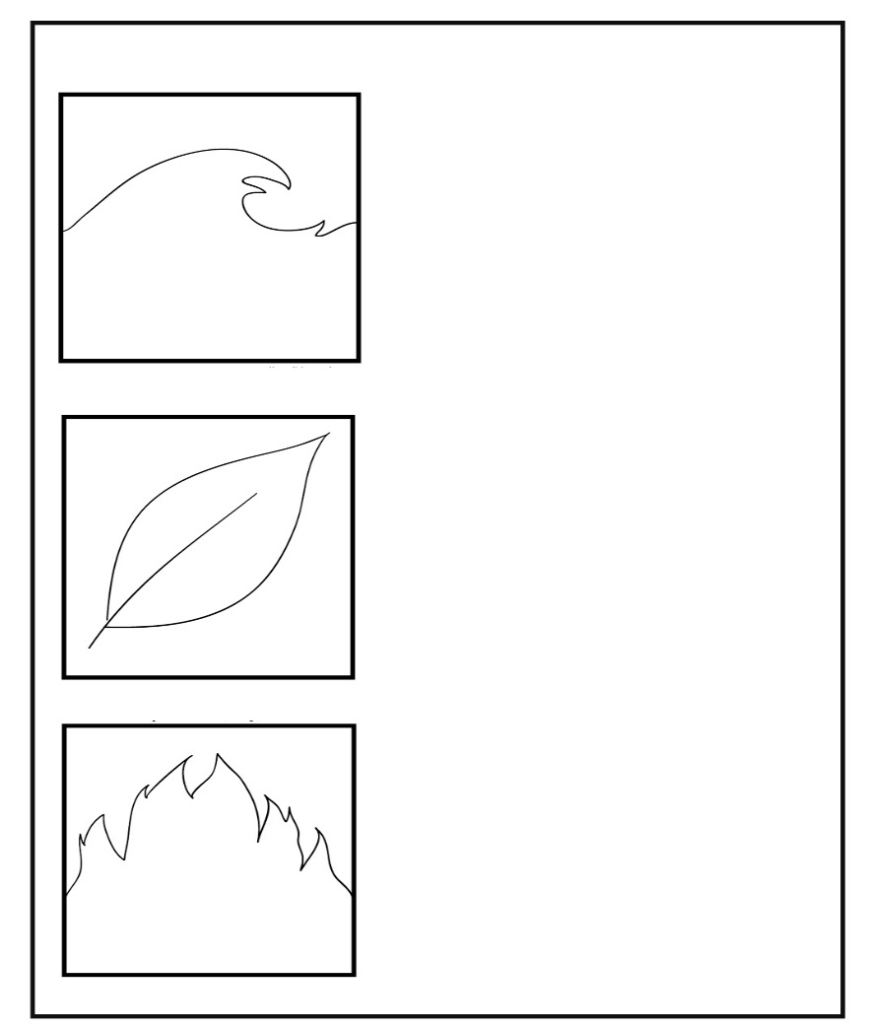
Oil Pastel Blending
Use a ruler to draw 3 squares that measure 4 inches by 4 inches.
Draw one of the following elements in each square: a wave, a leaf and fire.
Use the following color schemes and techniques for each element:
wave - white, light blue, dark blue with scrumbling and stippling in the background.
leaf - yellow, light green, dark green with heavy pressure blend in leaf and a color gradient in the background.
fire - yellow, orange, red with a pressure blend and a complimentary color in the background.
Click HERE! for a step-by-step tutorial on blending with oil pastel.

Slide 5
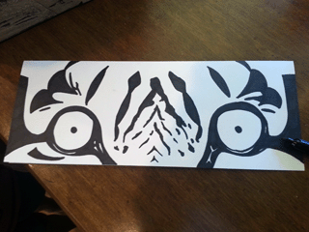
Oil Pastel Tiger Eye Practice
Click HERE for a step-by-step tutorial on how to draw a pair of tiger eyes.

Slide 6
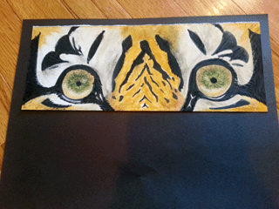
Oil Pastel Tiger Eye Practice
Click HERE for a step-by-step tutorial on how to add oil pastel to a pair of tiger eyes.

Slide 7
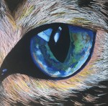
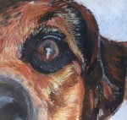
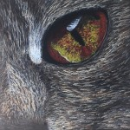
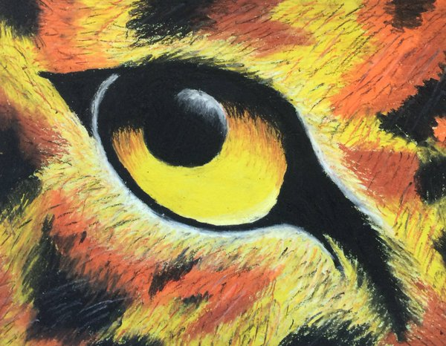
Oil Pastel Animal Eye

Slide 8
Blending
Oil pastels are made to be very blendable---they are soft, oily and designed to be mixed and spread together on the paper. For this project there should be evidence of blending and your designs must fill the entire paper. Blending can be done by using your finger or paper towel however it gets fuzzy. The best blending is just by layering colors on top of one another.

Slide 9
Texture
You can also create textures by first applying bold color to the paper and then going over it with another color until it is completely covered. Next, use a paper clip to scratch off the second color, revealing the color underneath. It creates a result similar to a scratchboard.

Slide 10
Oil Pastel Tips
• Oil pastels are messy - if the tip of your oil pastel is dirty, use a paper towel to wipe the tip off. • Oil pastels smudge – put a paper towel or scrap paper underneath you hand as you color to protect your art and help keep you hands clean. • Always blend with the lighter color. • White can be added at the end as a highlight. Simply blend over the top of a light area using white oil pastel

Slide 11
Procedure
1. Get a black paper and pick a print-out that you want to work from for reference. Put your name on it, you will need this to draw from and hand in with your finished project, so don’t lose it! 2. Find the middle of your reference photo and black paper using a ruler. Lightly draw a + sign all the way to the edge on each so you can reference placement and proportion. This will simple grid technique will help you know where to draw the main details.

Slide 12
Procedure
3. LIGHTLY draw with pencil to layout the main areas of your composition. Do not draw all of the tiny details like fur and feathers.

Slide 13
Procedure
4. Once everything is laid out, start coloring your lightest areas using short strokes. Don’t worry too much about the tiny details, yet. You’ll be doing a lot of layering. 5. After the light areas, color your middle tone areas. 6. Once the middle tones are done, color your darkest areas.

Slide 14
Procedure
7. After your colors are laid down, now you can go back and add texture and details by layering the pastels on top of one another. Try to avoid smudging, let the oil pastels blend by coloring on top of one another.

Slide 15
Procedure
8. Hand in your artwork with your name on the back along with this rubric.

Slide 16
Rubric
Click HERE for Rubric.

