Slide 1
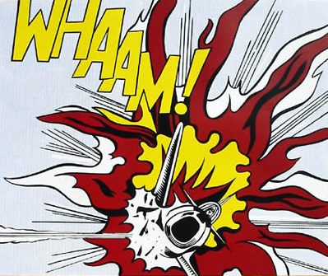
The Art of Roy Lichtenstein

Slide 2
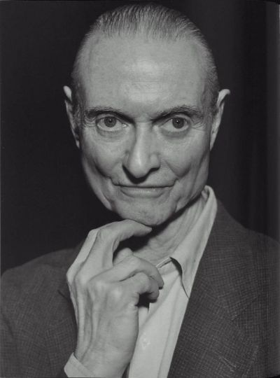
Biography
Lichtenstein was born in New York in 1923.
He served in the Army during World War II.
After the Army, he worked as a commercial designer, and then as a professor at various universities.

Slide 3
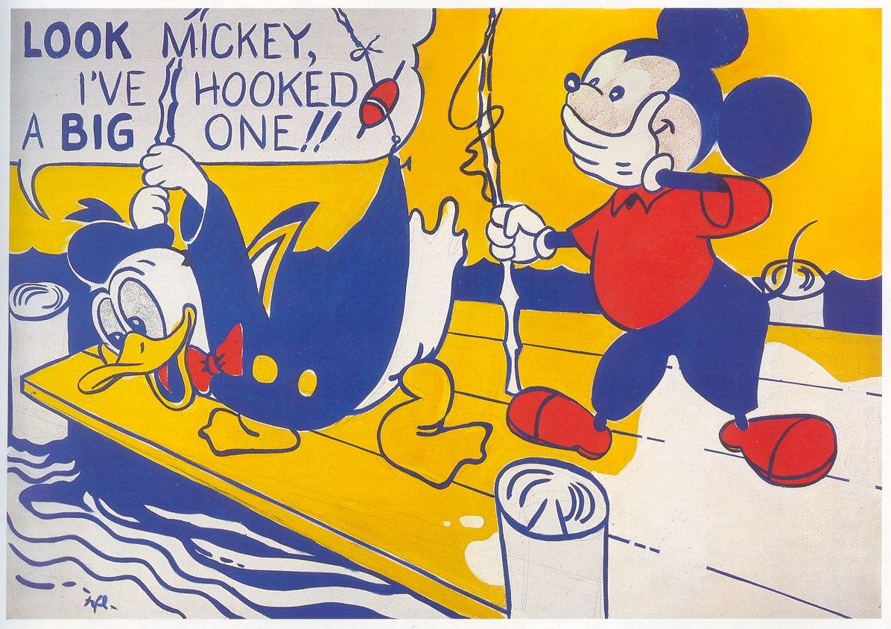
Painting Style
Lichtenstein experimented with different painting styles, but eventually became known for his comic book style.
His first painting in this style was of Mickey Mouse and Donald Duck

Slide 4
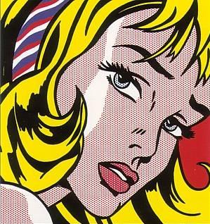
Painting Style
Lichtenstein’s paintings, like comic strips, often had areas filled with repeating dots – Ben Day dots.

Slide 5
Painting Style
He stenciled in each dot by hand, but wanted his artwork to look machine-made. He did not want his brush strokes to be seen.

Slide 6
Painting Style
Like comic strips, Lichtenstein often included a speech balloons.

Slide 7
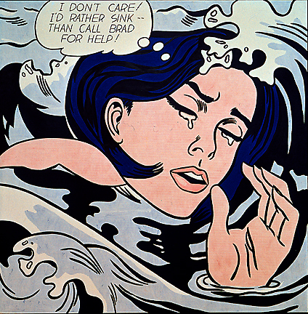
Painting Style
He often portrayed women in distress, drawing on the romantic teen magazines that became popular after WWII.

Slide 8
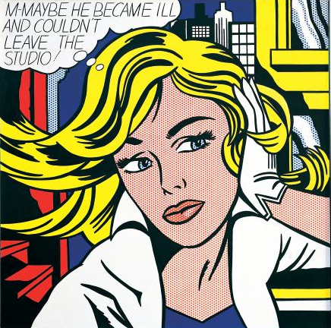
Damsels in Distress

Slide 9
War Paintings
War was another popular subject in Lichtenstein’s paintings.
These paintings again reflected images that he saw in magazines and comic books.

Slide 10
BLAM and WHAM!

Slide 11
His Own Colors
Though he got his ideas from magazines and comic books, Lichtenstein made the images his own by limiting his color palette to mostly primary colors, white, and black.

Slide 12
Pop Art
Lichtenstein’s work was considered Pop Art – an art movement that challenged art traditions by using popular commercial images as art.
Pop Art is inspired by familiar images from pop culture.
What popular commercial images did Lichtenstein use in his art?
Keeping his previous jobs in mind, why do you think Lichtenstein started creating Pop Art?

Slide 13
Later Years
After about 1965, Lichtenstein left the comic strip style behind and began painting in other styles. However, was the comic strip style that made him famous.
He died of pneumonia in 1997.

