Slide 1
Digital Media & Design
Ms. Mehalko – Room 2002

Slide 2
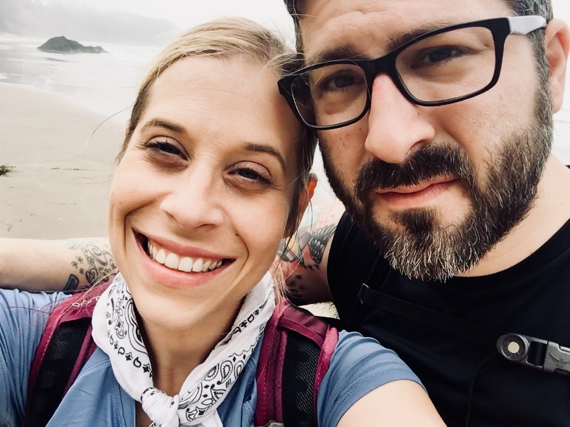
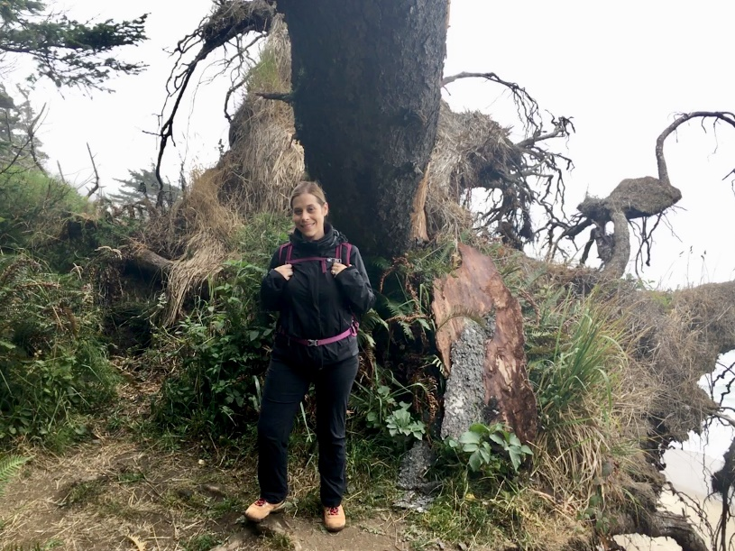
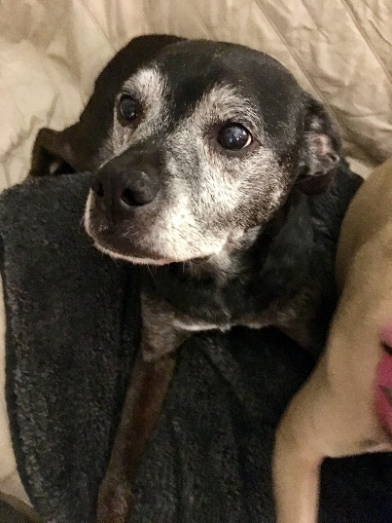
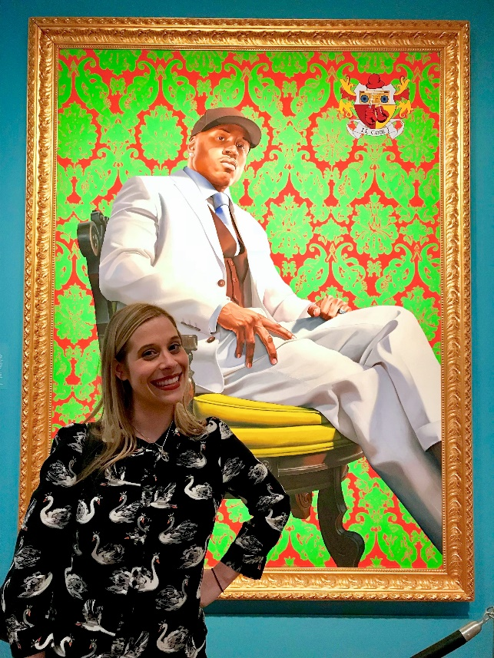
Mrs. Mehalko
My husband is a math teacher at HSHS.
I have three dogs – Hitchcock, Sadie and Jasper.
I like to cook, garden and hike.

Slide 3
Syllabus - Overview
Digital Media Art Design I is a full year course with exams.
There will be tests and projects throughout each nine weeks.
We will be exploring the use of technology in art, and studying a variety of artists and concepts.
Explores the vast applications of Photoshop CC.
Includes both teacher-led instruction and independent studio time.
There is a $12.00 art fee for this course.

Slide 4
Syllabus -Materials
A school laptop is required for this course. Laptops must be obtained to maintain enrollment in the course.
Students who have not complied with the mandatory technology requirements for the course by the deadline will be placed in another elective.
HCPS laptops provide student access to innovative software such as Photoshop CC. All projects will be completed using Photoshop CC.
A personal laptop will not suffice as a substitution.
You must bring your laptop, charger and pencil to class every day.

Slide 5
Syllabus – Assignment
Work is due on its assigned date. This includes project, sketchbook assignments and classwork.
Exceptions will only be made for excused absences. Unexcused late work will result in the loss of 5 points for each day late for written work.
Late Policy
Day 1 – 5 points
Day 2 – 5 points
Day 3 – 5 points
Late point deductions will stop at a 65%

Slide 6
Syllabus – DMAD Folder
You will maintain a DMAD folder throughout the year that will contain:
PS Practice Assignments
Notes
Vocabulary
Information needed to complete your projects.
Folders should remain in the classroom.

Slide 7
Syllabus - Attendance
Daily attendance is mandatory to ensure that you are able to stay on task and not fall behind on projects.
Use your class time wisely. You will be provided with plenty of time to complete work in class.
An excused absence allows students the number of classes missed plus a day to make up the work. If you have an excused absence, it is your responsibility to make arrangements to make-up missed work within a week of your return to school.
Work may not be taken home to complete – do not ask.
Exceptions will only be made for chronic illness, a family emergency, etc.

Slide 8
Syllabus – Use of Technology
Classroom and school equipment should be used gently. We must work together to preserve our equipment for as long as possible so that future classes may enjoy its use.
While in class, you are expected to remain on school-related websites and computer art-related assignments.
Those who find themselves distracted when using the computer will be given an alternate written assignment.

Slide 9
Syllabus – Back Up Your Work
Technology, while powerful, can also be extremely unreliable. It is important that you back up your work in case your computer crashes. The help desk often wipes your drive clean, and your work may be sacrificed in order to repair your computer.
You can back up on the server if you are on your laptop at school.
I also highly recommend purchasing a flash memory drive to back up your work and transfer files to the lab computers, if needed. Flash drives can be purchased fairly inexpensively in the electronics section at most major stores: Wal-Mart, Target, etc.

Slide 10
Syllabus - Website
All projects and visual journal assignments will be posted on the class website at www.artebeau.weebly.com under the Digital Media Art Design I tab.
It is essential that you check this website on a regular basis for announcements, project updates, and notes.
Please bookmark this site, as we will be referring to it on a daily basis.
www.artebeaux.weebly.com

Slide 11
Syllabus - Expectations
Keep your visual journal neat, organized, and updated.
Use classroom time wisely and ask for extra help if needed.
I set high standards for your work – I expect you to do the same.
Expect reading and writing to accompany most projects and activities.
No drinks, food, or candy may be consumed in class. A bottle of water is acceptable.
Safety is a primary focus. Proper use of materials and equipment must be a commitment of each student.
Mutual respect and courteous behaviors are important if an intellectual exchange of ideas and opinions are to take place. Appropriate language and conversation topics are expected.
While working on a project, you may talk quietly with your neighbors. I do, however, expect your full attention when I am speaking to the class.

Slide 12
Syllabus - Grading
50% Projects – 2-4 per marking period.
30% Tests – Art of the Week, reflections, and critiques
20% Classwork/ Homework – progress checks, written assignments, media studies, homework, participation

Slide 13
Syllabus - Signature
First homework assignment:
Next class: Return your syllabus signed by you and your parent/guardian

Slide 14
Art Release
Second homework assignment:
Next class: Return your completed and signed art release

Slide 15
Student Information Sheet
Complete and submit in the blue turn in bin on the front table.

Slide 16
What Are We Going to Make?
Elements & Principles

Slide 17
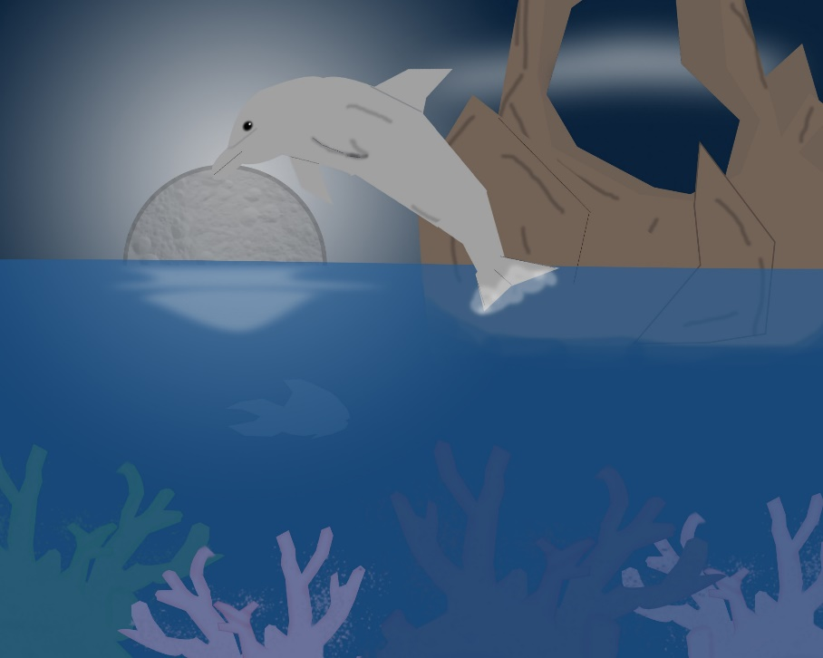
What Are We Going to Make?
Shapescape

Slide 18
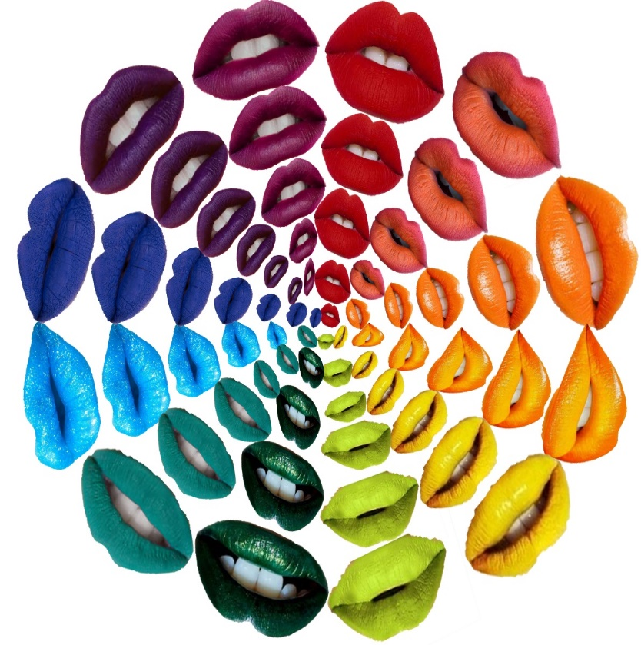
What Are We Going to Make?
Color Wheel

Slide 19
What Are We Going to Make?
Self-Portrait Collage

Slide 20
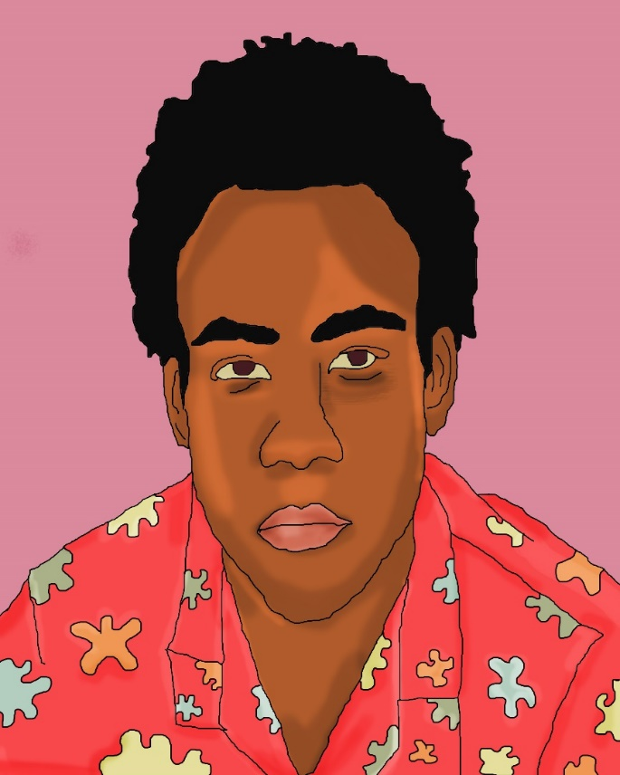
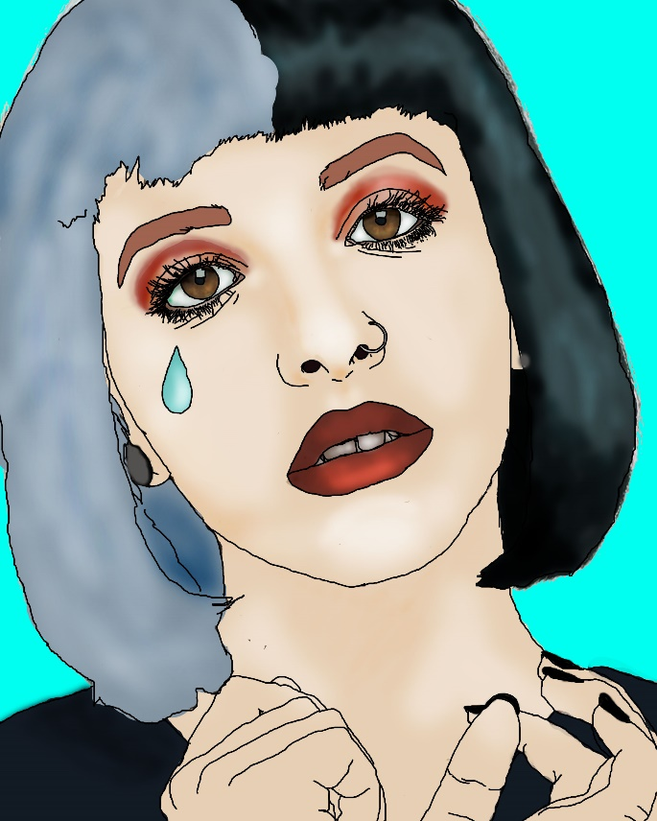
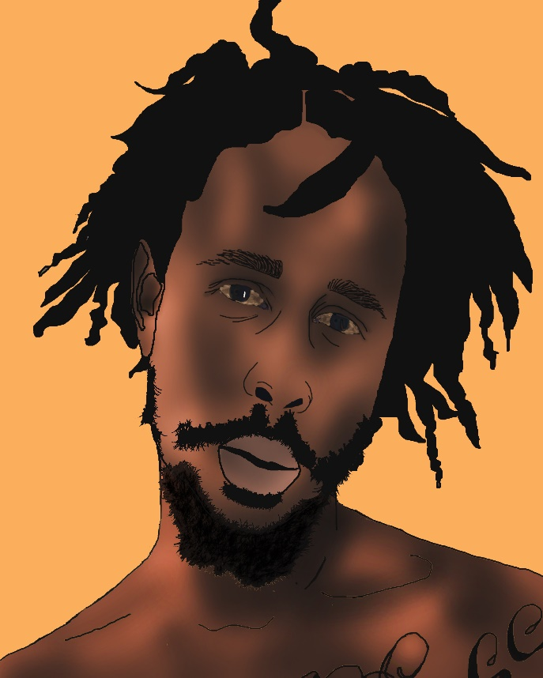
What Are We Going to Make?
Celebrity Portraits

Slide 21
What Are We Going to Make?
Texture Music Collage

Slide 22
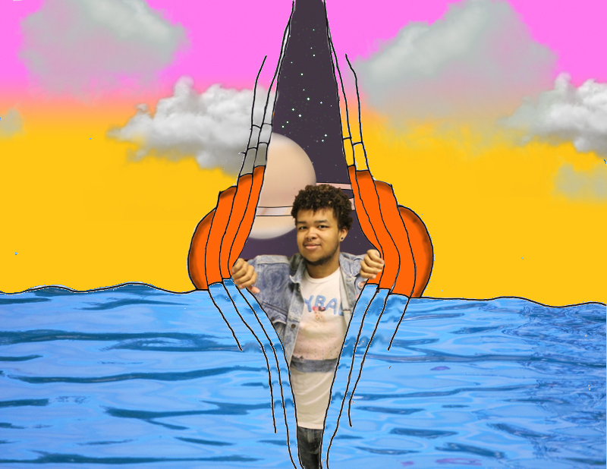
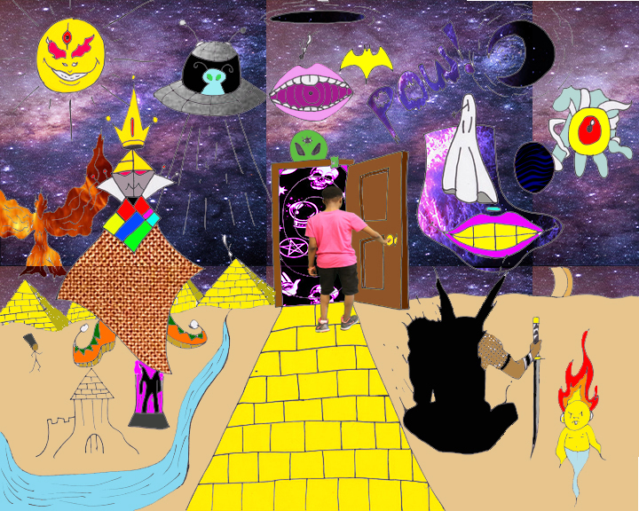
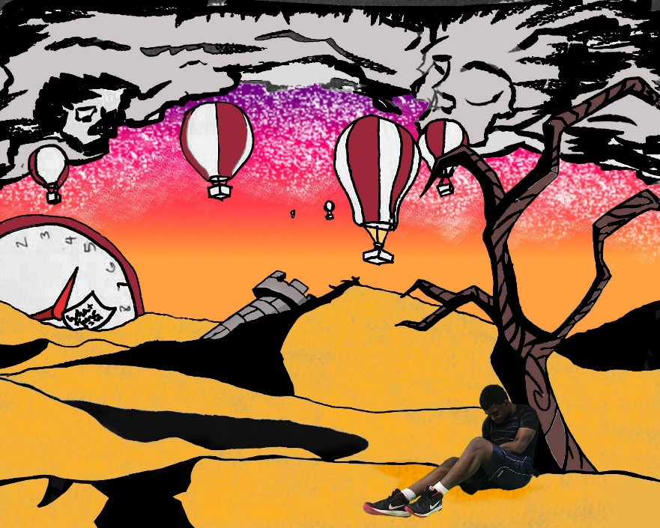
What Are We Going to Make?
Surreal Landscape

Slide 23
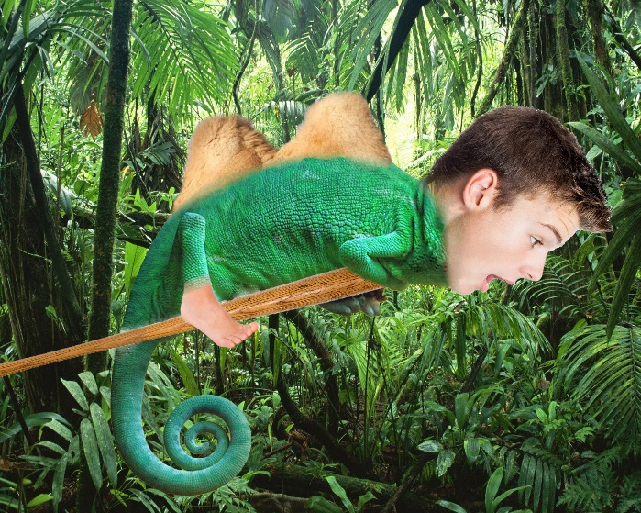
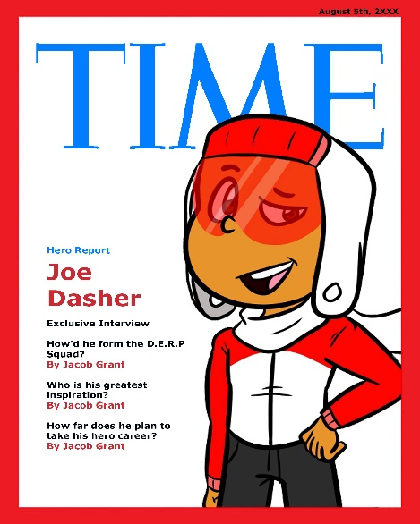
What Are We Going to Make?
Visual Journals

Slide 24
Your Artistic Background
Help me get to know you as an artist!
The only wrong answer is an incomplete answer!

Slide 25
Two truths and a lie
Tell your classmates 3 things about yourself.
Two of these things must be true and 1 thing must be untrue.
The class must guess what is true and what is a lie.

Slide 26
PRIDE
Students will complete a PRIDE opinion poll.
The poll will be used to create a set of standards that exemplify what PRIDE means in our classroom.

Slide 27
Basic Computer Skills
Helps me gauge our class’s computer knowledge right now
Helps me gauge our class’s growth later on in the year
The only wrong answer is an incomplete answer!
If you don’t know, take a guess!

Slide 28
DMAD Folder Cover
Students will use magazines to explore graphic design possibilities
Students will create a collage of images that represent who you are and things that you like.

