Slide 1
Art of the Week
Study Guide
&
Test Images
2018-2019

Slide 2
Semester 1
MIDTERM EXAM

Slide 3
Study Guide
Title | Fact | Media
Lion Man of Hohlenstein- Stadel | Oldest known anthropomorphic carving in the world. | Mammoth ivory
The Stele of Hammurabi | Written in cuneiform meaning "wedge-shaped"; one of the earliest systems of writing. | Basalt
Judith Slaying Holofernes | Baroque art used intense, warm colors, a contrast of light and dark, and depicted moments of great movement and drama. | Oil on canvas
Washington Crossing the Delaware | Artist hoped to encourage liberal reform in Europe using the American Revolution as an example. | Oil on canvas
Migrant Mother | Photos humanized the impact of the Great Depression on everyday Americans. | Photographic film, Gelatin Silver Print
Guernica | Considered by many as one of the most powerful anti-war paintings in history.​​ | Oil on Canvas
For the Love of God | Death is a central theme in the artist's work. | platinum, diamond, human tooth

Slide 4
Study Guide
Title | Fact | Media
Self-portrait with a Bandaged Ear | Artist shows himself with a sad facial expression; possibly contemplating his worth as an artist. | Oil on canvas
Chain Gang | African-American artist best known for his paintings and prints of landscapes and portraits. | Oil on plywood
Autumn Rhythm (Number 30) | Famous for helping to create a whole new art movement called Abstract Expressionism. | Enamel on canvas
Infinity Mirror | Known for extensive use of polka dots and infinity installations. | Stuffed cotton, board & mirrors

Slide 5
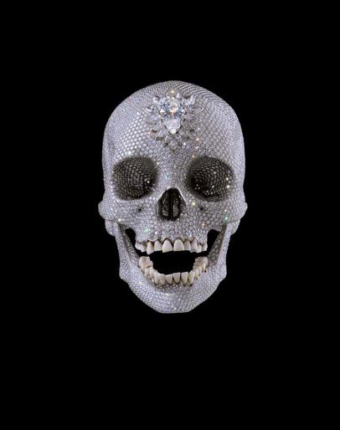
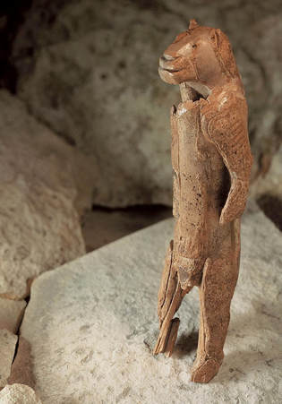
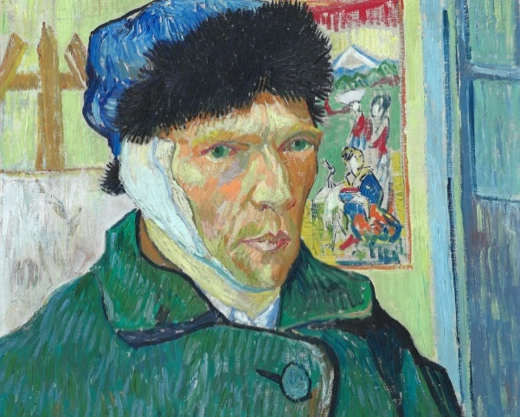
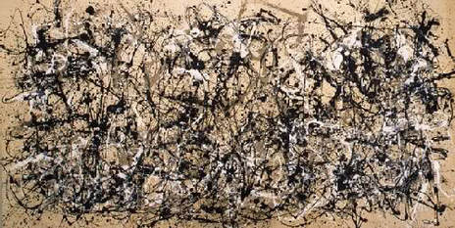
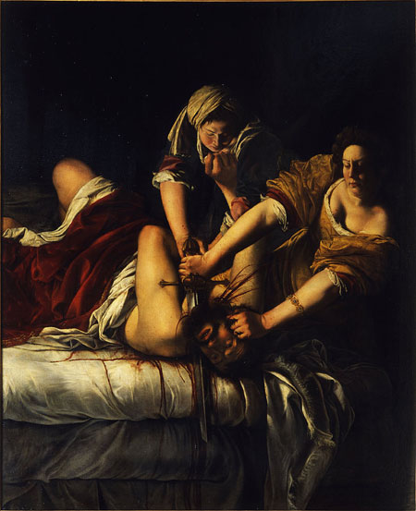
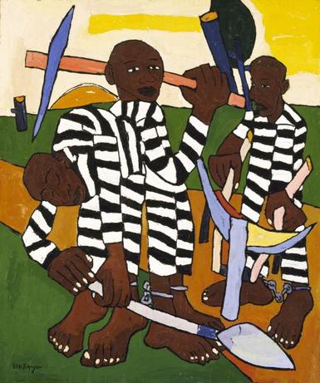
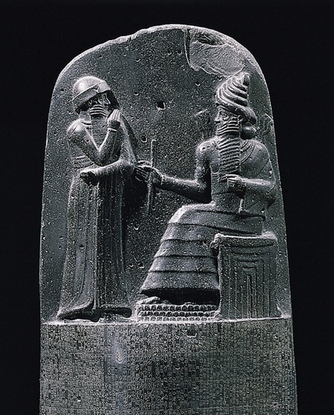
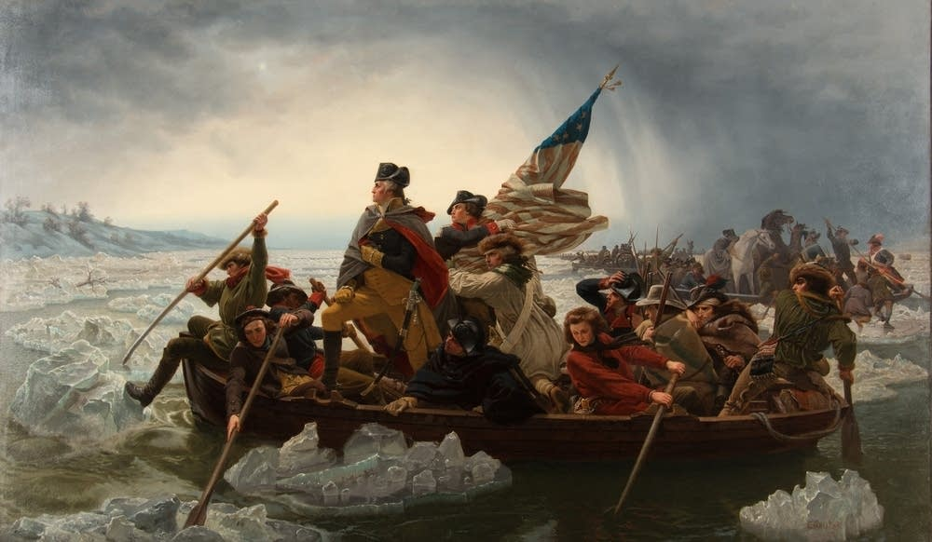
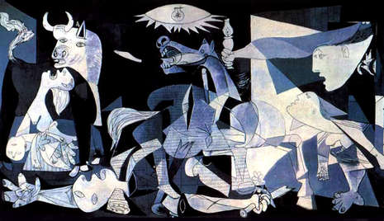
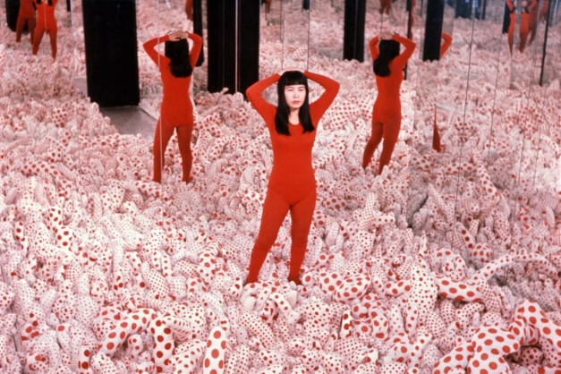
4
5
1
2
3
9
6
7
8
10
11

Slide 6
Semester 2
FINAL Exam

Slide 7
2
4
5
1
3
9
6
7
8
11
10
12
13
14
15
16

