Slide 1
Art of the Week
Test Images 2017-2018

Slide 2
Quarter 1
Test

Slide 3
Study Guide
Title | Fact | Media
Nefertiti Bust | Natural representation was encouraged due to Pharaoh being a radical reformer and artist | Limestone with painted plaster
Mask of Agamemnon | Made using a single gold sheet and repuosse | Gold
Madonna and Child | Icons represent holy images as a conduit to Christ, his mother Mary, or other saints | Tempera
School of Athens | Extraordinary example of linear perspective | Fresco (plaster and paint)
Las Meninas | Viewpoint is widely debated | Oil on Canvas
At the Moulin Rouge | Contains portraits of dance hall regulars | Oil on Canvas
The Two Fridas | Artist portrayed physical flaws and emotions openly | Oil on Canvas
Ice T | Paints modern day African-Americans combined with historic paintings | Oil on Canvas

Slide 4
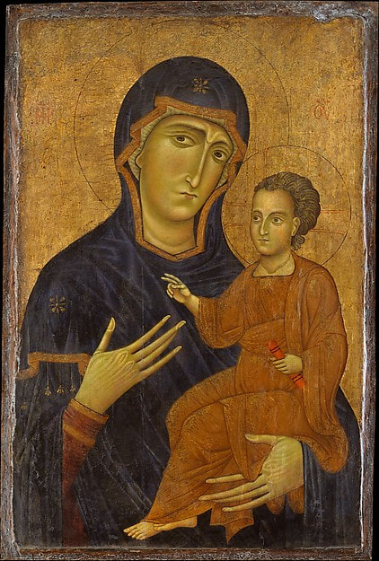
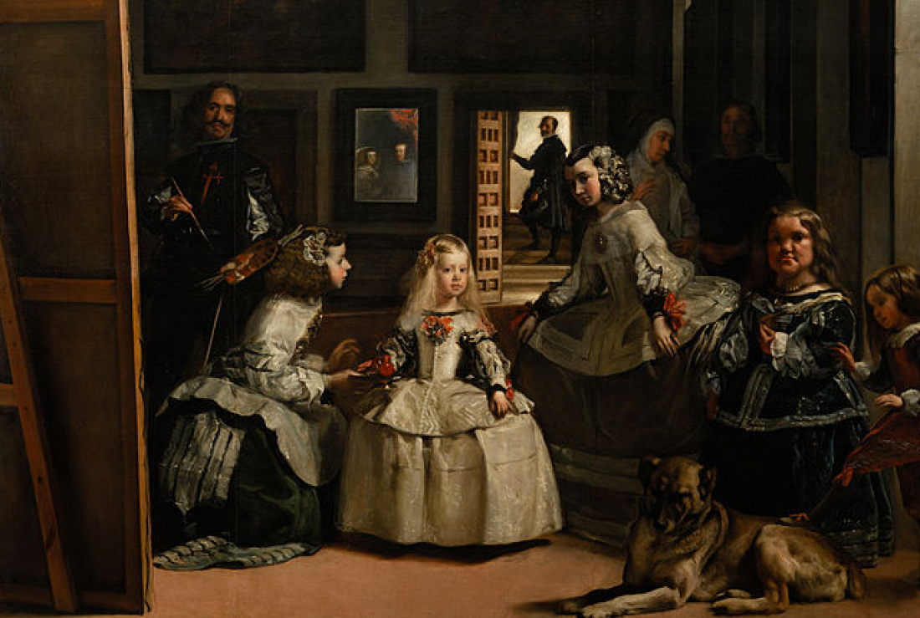
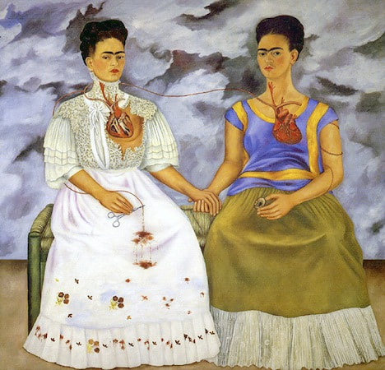
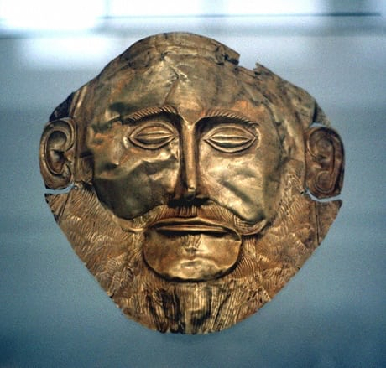
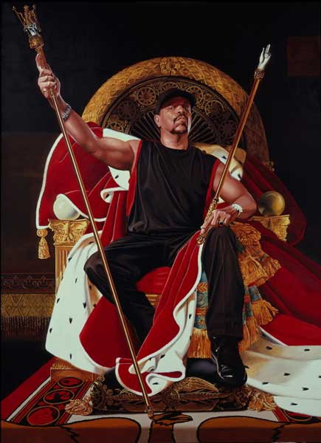
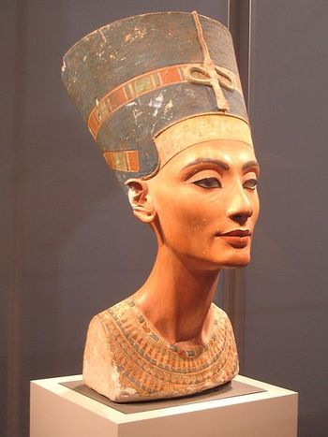
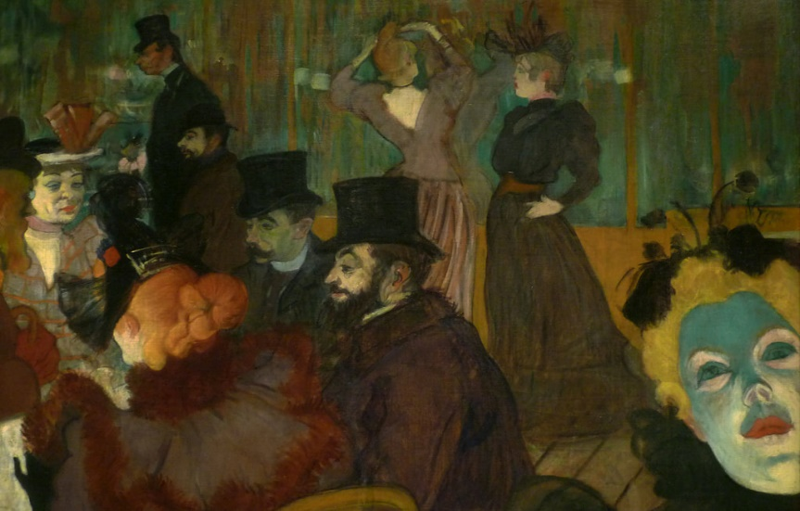
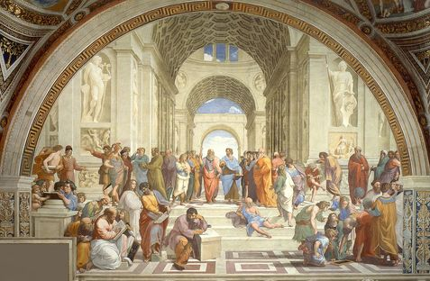
A
B
C
D
E
F
G
H

Slide 5
Semester 1
Test

Slide 6
Study Guide
Title | Fact | Media
Nefertiti Bust | Natural representation was encouraged due to Pharaoh being a radical reformer and artist | Limestone with painted plaster
Mask of Agamemnon | Made using a single gold sheet and repuosse | Gold
Madonna and Child | Icons represent holy images as a conduit to Christ, his mother Mary, or other saints | Tempera
School of Athens | Extraordinary example of linear perspective | Fresco (plaster and paint)
Las Meninas | Viewpoint is widely debated | Oil on Canvas
At the Moulin Rouge | Contains portraits of dance hall regulars | Oil on Canvas
The Two Fridas | Artist portrayed physical flaws and emotions openly | Oil on Canvas
Ice T | Paints modern day African-Americans combined with historic paintings | Oil on Canvas

Slide 7
Study Guide
Title | Fact | Media
Mona Lisa | Noted as the world's most famous painting. | Oil on Poplar Wood
The Sistine Chapel | Includes over 340 human figures representing the origin and fall of man. | Fresco (paint and plaster)
The Scream | ​The painting represents the fear of losing one's mind. | Oil, pastel, tempera on cardboard
Starry Night | Used a technique called impasto - layers of thick brushstrokes that create texture | Oil on Canvas
The Persistence of Memory | Juxtaposed everyday objects with unusual scenes | Oil on Canvas
American Gothic | The highly detailed and polished style is influenced by Flemish Renaissance | Oil on Canvas
Marilyn Monroe | Movement obsessed with pop culture/mass production | Acrylic on Canvas
Crack is Wack | The artist started by creating graffiti with permanent marker on the NYC subways

Slide 8
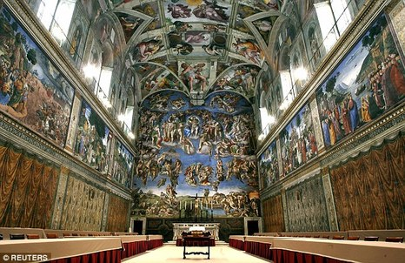
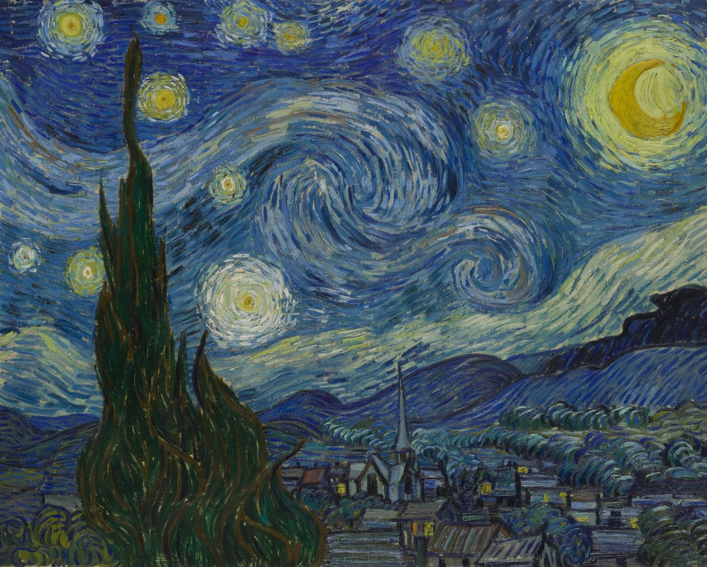
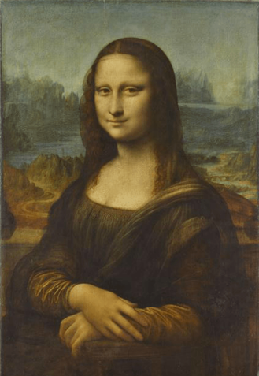
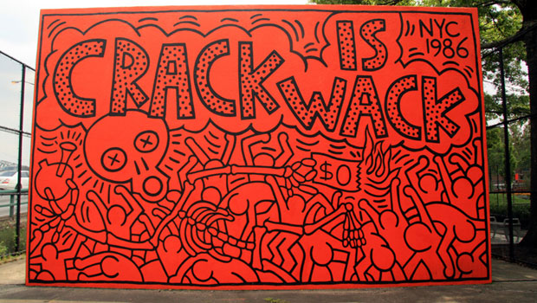
1.
2.
3.
4.
5.
6.
7.
8.

Slide 9
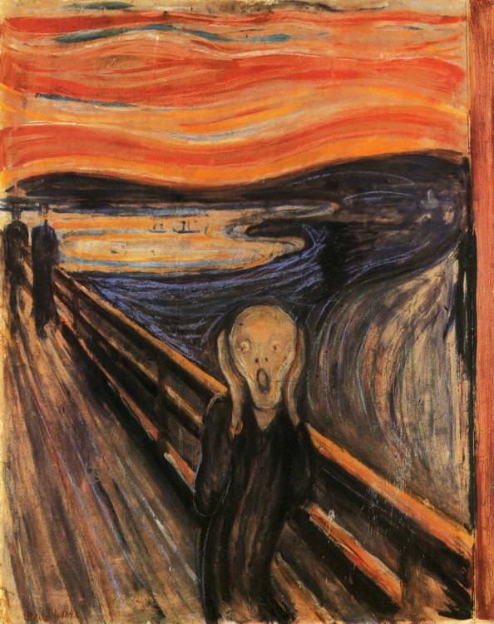
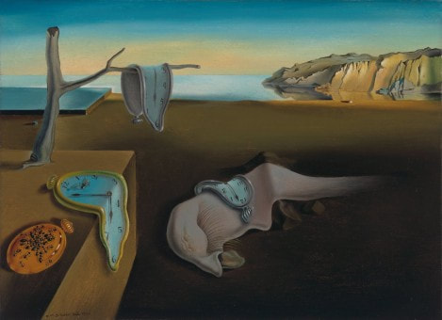
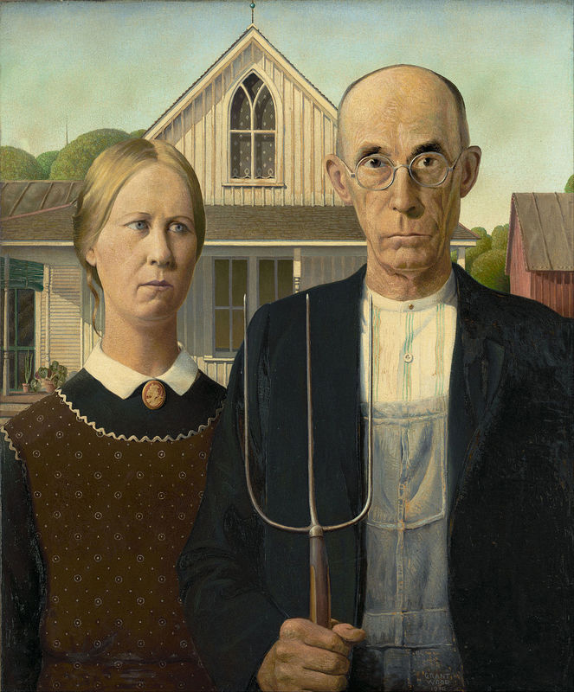
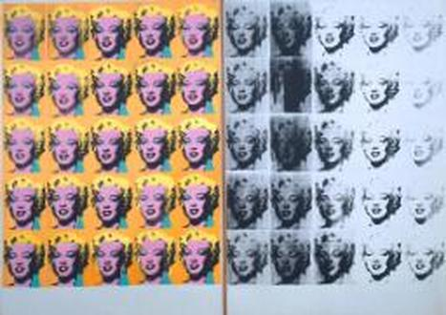
9.
10.
11.
12.
13.
14.
15.
16.

Slide 10
Quarter 3
Test

Slide 11
Study Guide
Title | Fact | Media
Terra Cotta Soldiers | Manufactured in workshops by government laborers and local craftsmen using local materials | Terracotta
The Wave | Mt. Fuji made tiny by the use of perspective | Polychrome woodblock print, ink, paper
Taj Mahal | ​Employed over 20,000 craftsman | White marble, precious stones, semi-precious stones, etc.
Rainbow Serpent | One of the most common and well known Aboriginal Dreamtime stories | Red and yellow ochre
Easter Island Moai | Placed atop ceremonial stone platforms called ahu | Tuff
The Sun Stone | Depicts the five worlds of the sun from Aztec mythology. | Basalt
Kanaga Mask | Worn at rituals called dama. | Wood, fiber, hide
Lakich’inei Pole | Depicts spiritual reverence, family legends, sacred beings and culturally important animals, people, or historical events | Western red cedar

Slide 12
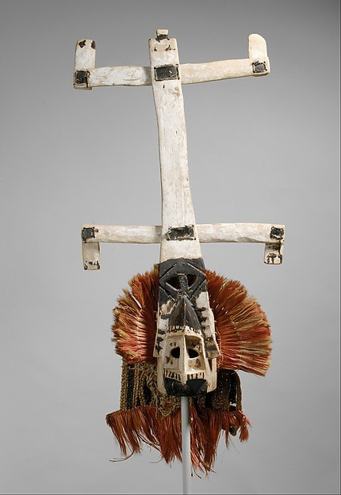
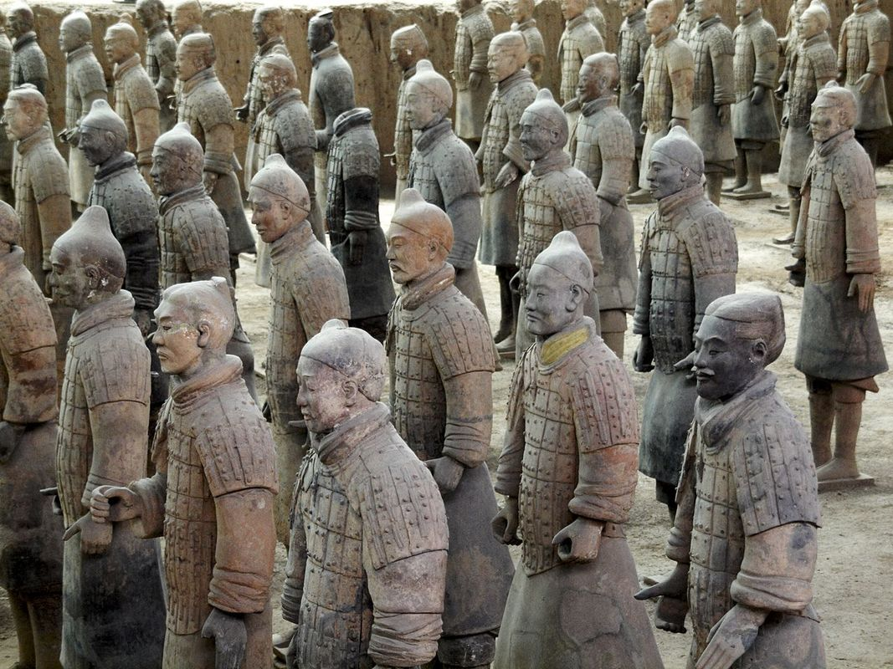
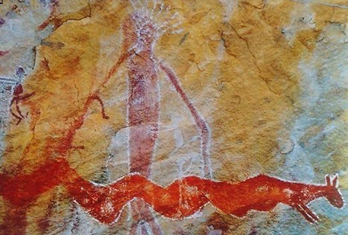
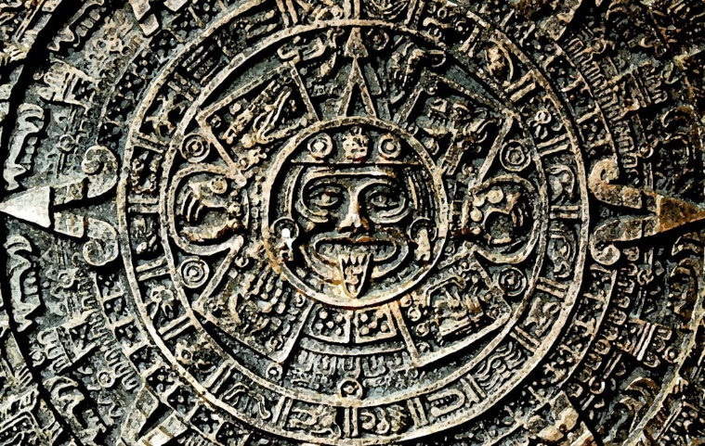
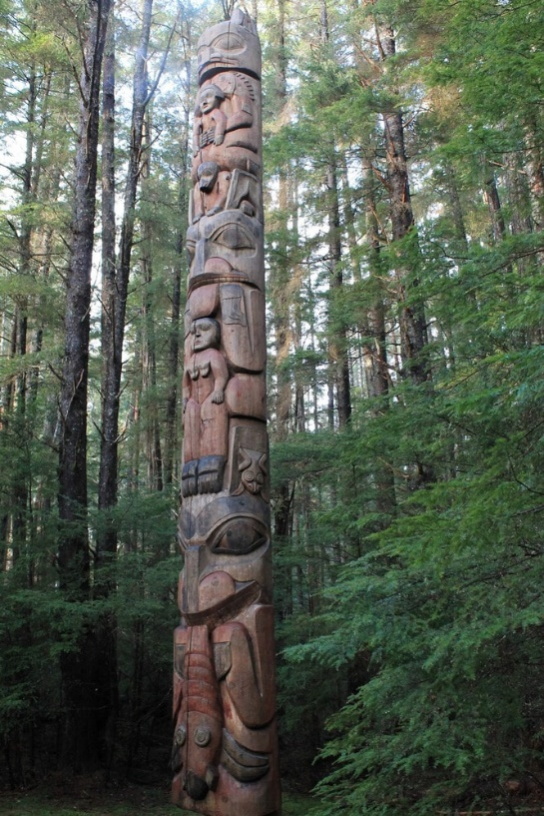
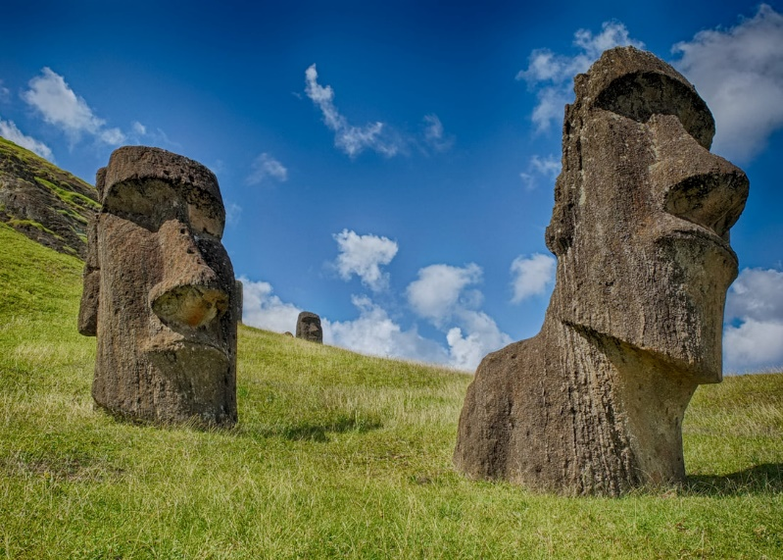
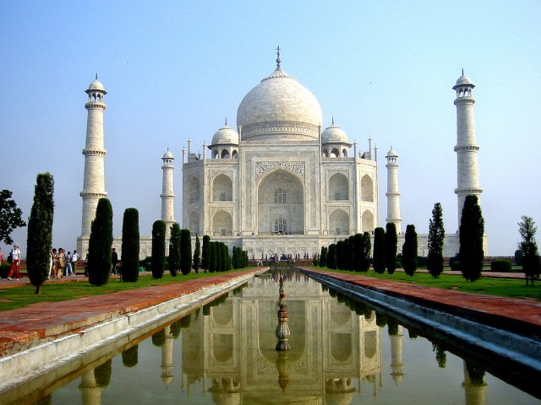
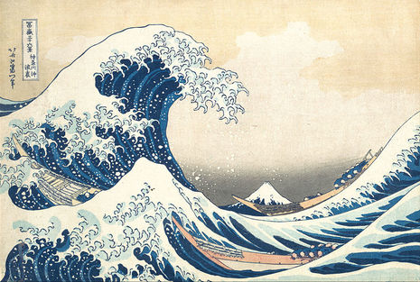
1
2
3
4
5
6
7
8

Slide 13
Semester 2
Exam

Slide 14
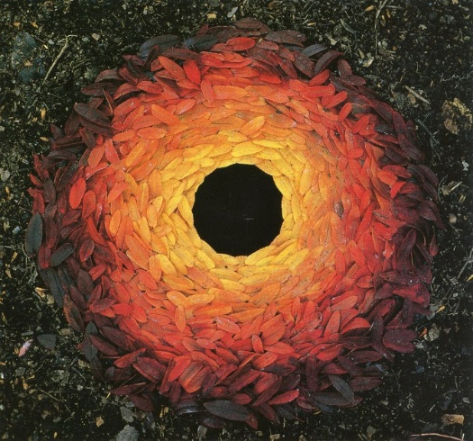
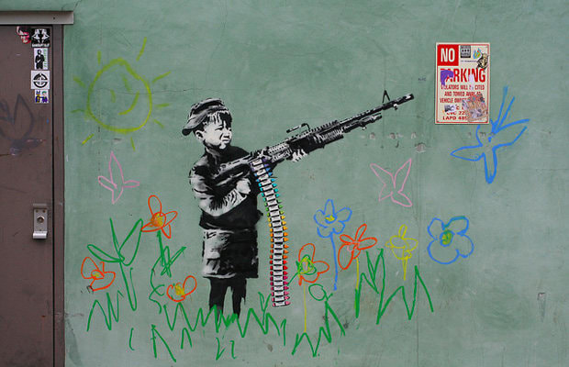
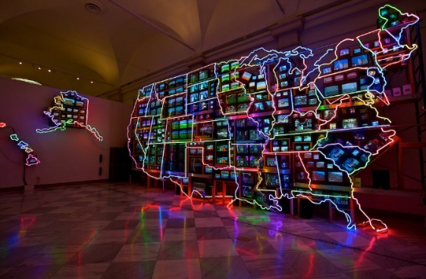
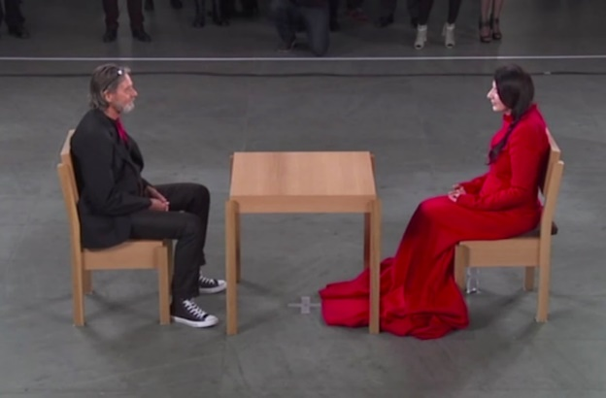
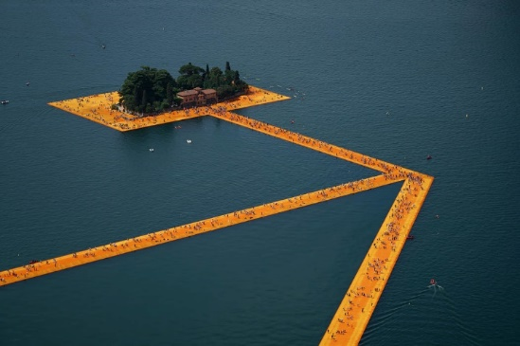
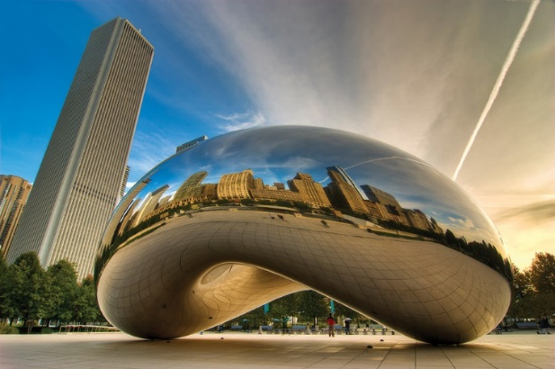
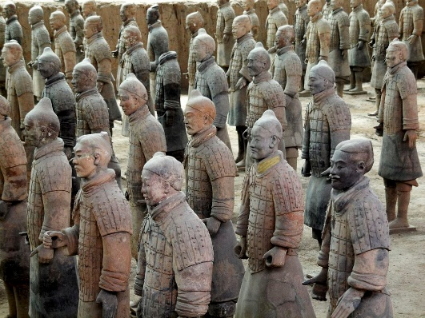
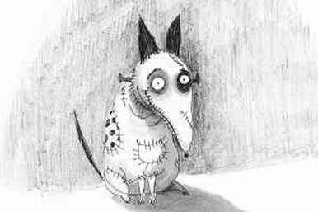
2
4
5
1
3
9
6
7
8
11
10
12
13
14
15
16

Slide 15
Study Guide
Title | Fact | Media
Terra Cotta Soldiers | Manufactured in workshops by government laborers and local craftsmen using local materials | Terracotta
The Wave | Mt. Fuji made tiny by the use of perspective | Polychrome woodblock print, ink, paper
Taj Mahal | ​Employed over 20,000 craftsman | White marble, precious stones, semi-precious stones, etc.
Rainbow Serpent | One of the most common and well known Aboriginal Dreamtime stories | Red and yellow ochre
Easter Island Moai | Placed atop ceremonial stone platforms called ahu | Tuff
The Sun Stone | Depicts the five worlds of the sun from Aztec mythology | Basalt
Kanaga Mask | Worn at rituals called dama | Wood, fiber, hide
Lakich’inei Pole | Depicts spiritual reverence, family legends, sacred beings and culturally important animals, people, or historical events | Western red cedar

Slide 16
Study Guide
Title | Fact | Media
Rowan Leaves with Hole | Artworks left to continue their natural process | Leaves and Hole
Cloud Gate | Inspired by liquid mercury | Stainless Steel
The Artist Is Present | ​Took place over 736 hours at Museum of Modern Art in NYC with 1,545 sitters | Performance
Floating Piers | Funded entirely by the sale of artist’s original works of art | Fabric and Polyethylene
Calvin and Hobbs | Refused to merchandise his creations as it devalued the characters and their personalities | Ink
Frankenweenie | Characters and narratives often represent the ‘outsider’, the misunderstood, the lonely, and the rejected | Ink/stop motion
Electronic Superhighway | Artwork humanizes technology | Television, steel, electronic component, neon
Crayola Shooter | ​Anonymous British graffiti artist whose work often features a dark sense of humor and social commentary | Paint

